Slide 1
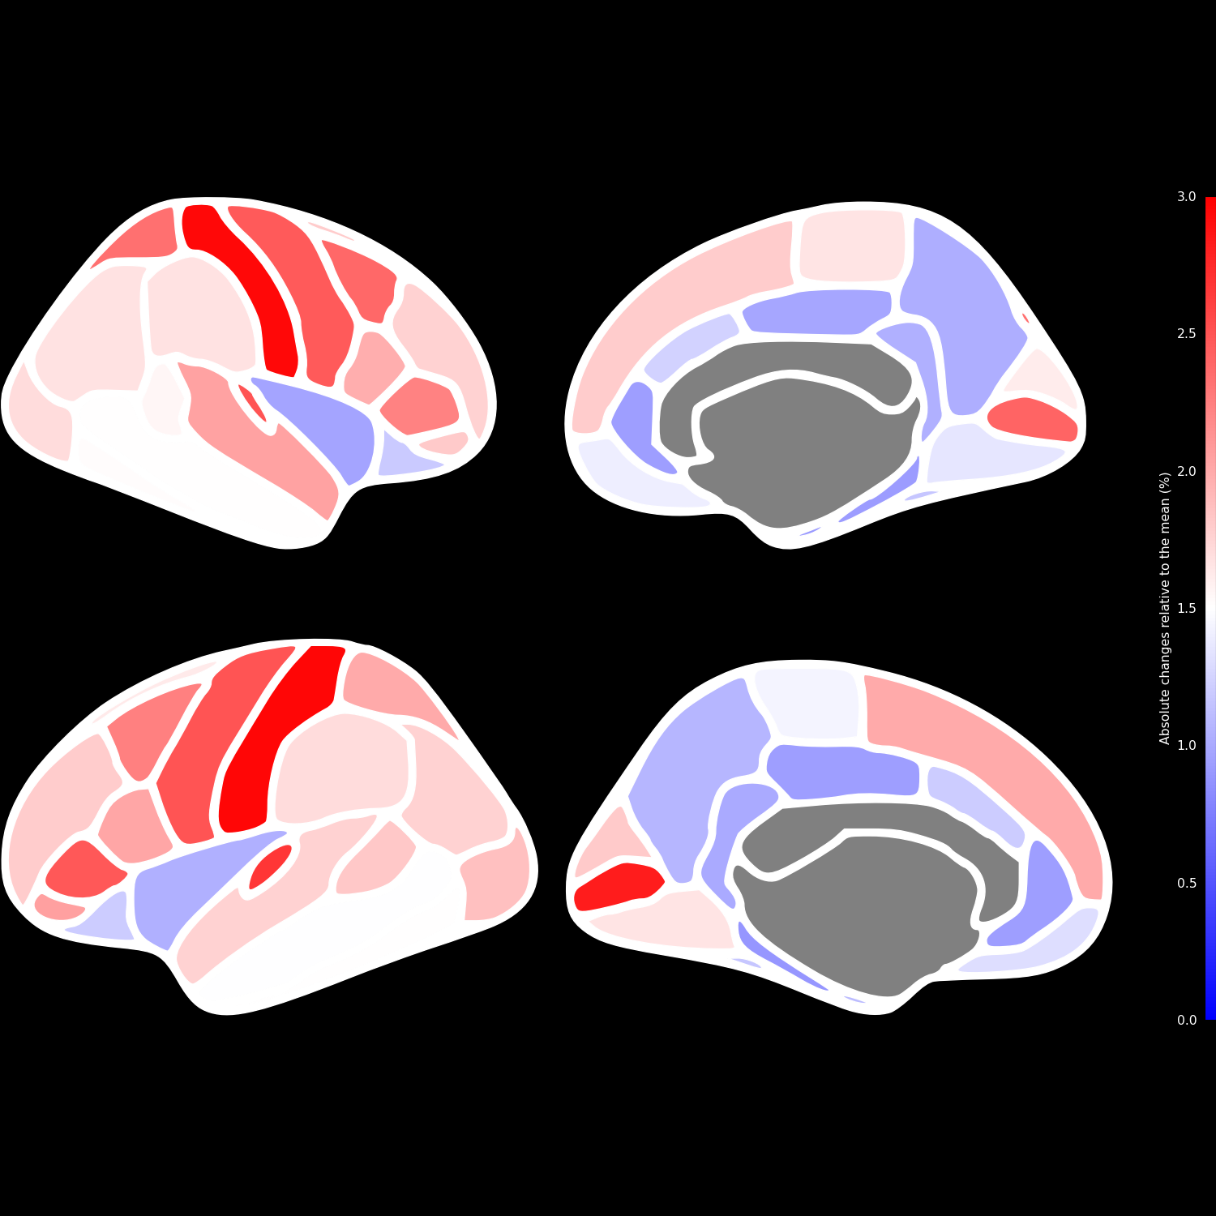
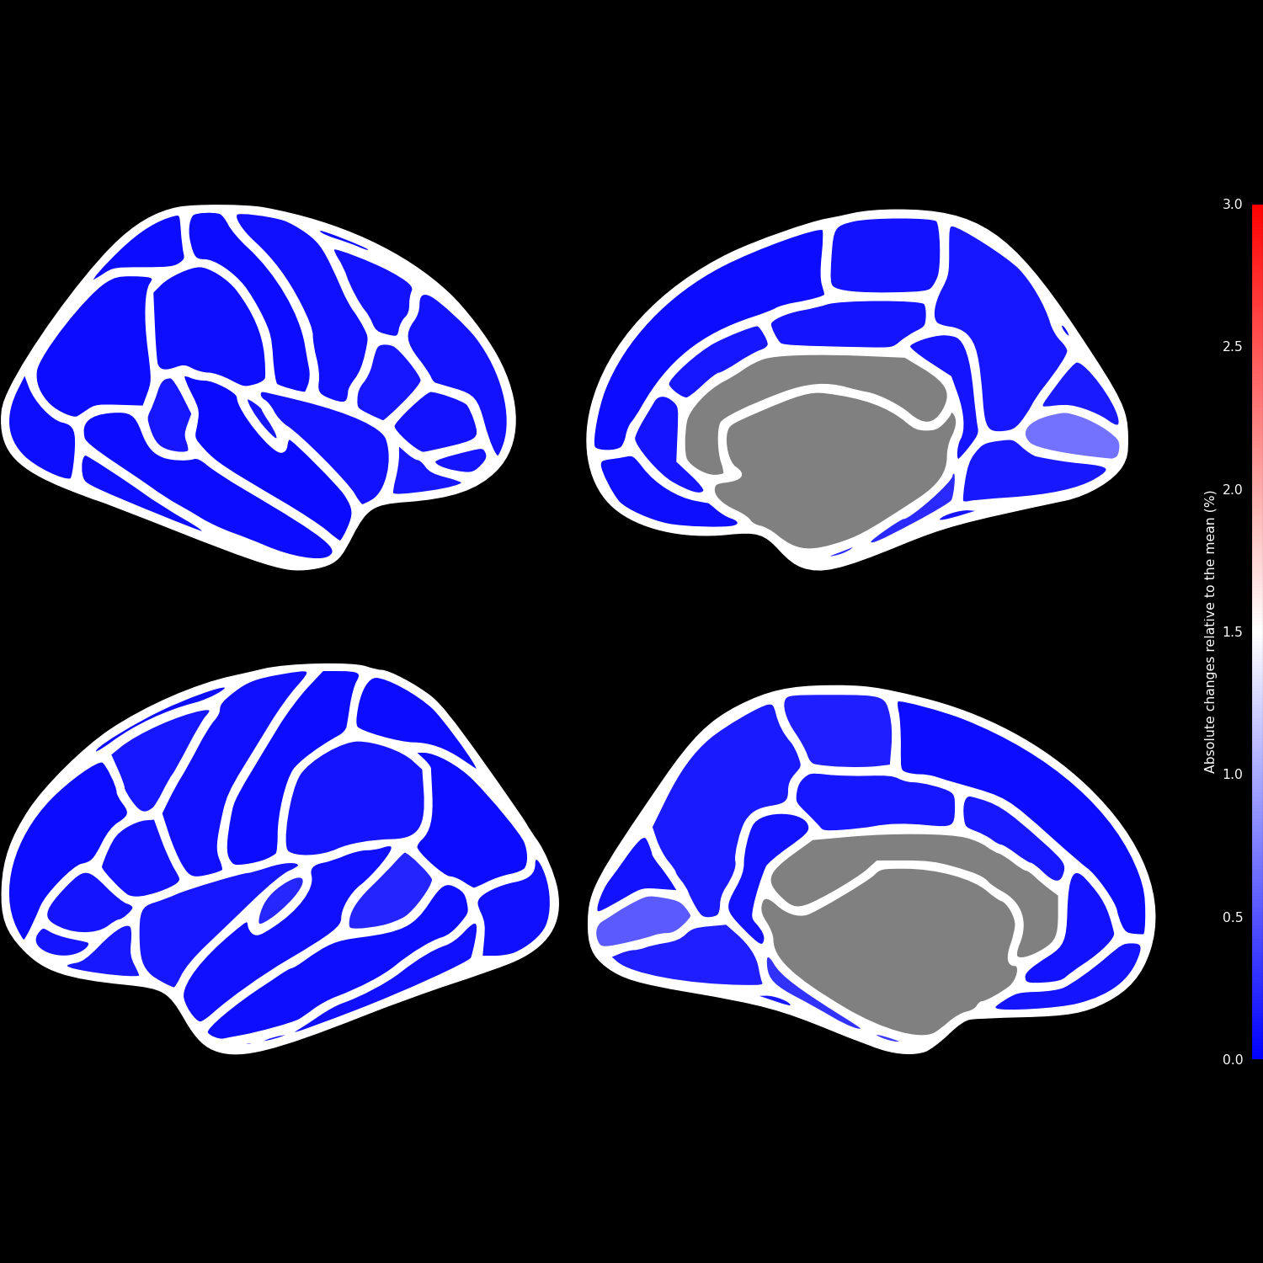
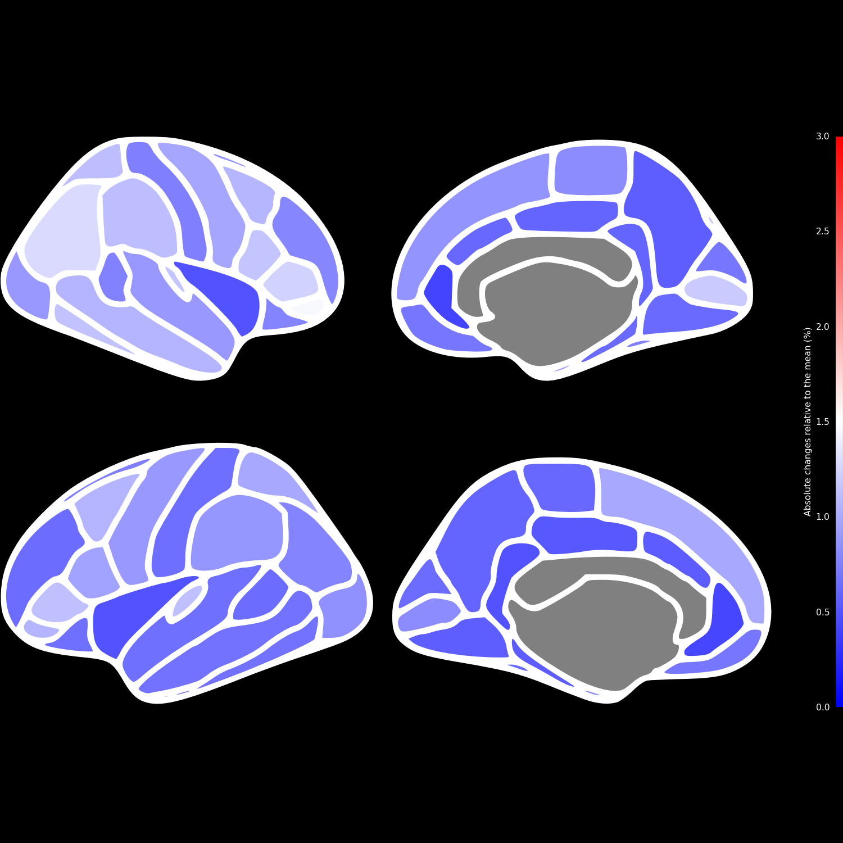
Left lateral
Left medial
Right lateral
Right medial
ANTs
ANTsPyNet
DL+DiReCT

